Slide 1

UNIT - 1
Java Programming

Slide 2
Introduction
  Java is a high-level, object-oriented programming language developed by Sun Microsystems (now owned by Oracle) in 1995. It is widely used for building cross-platform applications.
  Java's "Write Once, Run Anywhere" (WORA) philosophy allows code to be executed on any platform that supports Java without the need for recompilation. This is achieved through the Java Virtual Machine (JVM).
  Simple and Easy to Learn: Java has a clear syntax similar to C++, making it easy for beginners to understand.
  Object-Oriented: Java is based on the principles of OOP (Object-Oriented Programming), which promotes modularity and code reuse.
  Robust and Secure: Java provides strong memory management, exception handling, and security features.
  The JDK is a software development environment used to develop Java applications. It includes the Java Runtime Environment (JRE), an interpreter/loader (Java), a compiler (javac), an archiver (jar), and other tools.

Slide 3
Key Features of Java
Simple
Object Oriented
Platform Independent
Dynamic
Secure
Robust
Multithreaded
High Performance

Slide 4
Java Program Structure and Fundamentals
Basic Program Structure
Java programs have a well-defined structure, including a main method, class declarations, and other essential elements.
Java Tokens
Java programs consist of various tokens, such as keywords, identifiers, literals, and operators, each serving a specific purpose.
Importance of Comments
Proper commenting and code formatting are crucial for enhancing code readability and maintainability.

Slide 5
1
Command Line Arguments
Java programs can accept input from the command line, allowing for dynamic and interactive functionality.
2
User Input with Scanner
The Scanner class provides a simple and efficient way to capture user input within a Java program.
3
Escape Sequences
Escape sequences, such as \n and \t, allow for the inclusion of special characters and formatting in Java output.

Slide 6
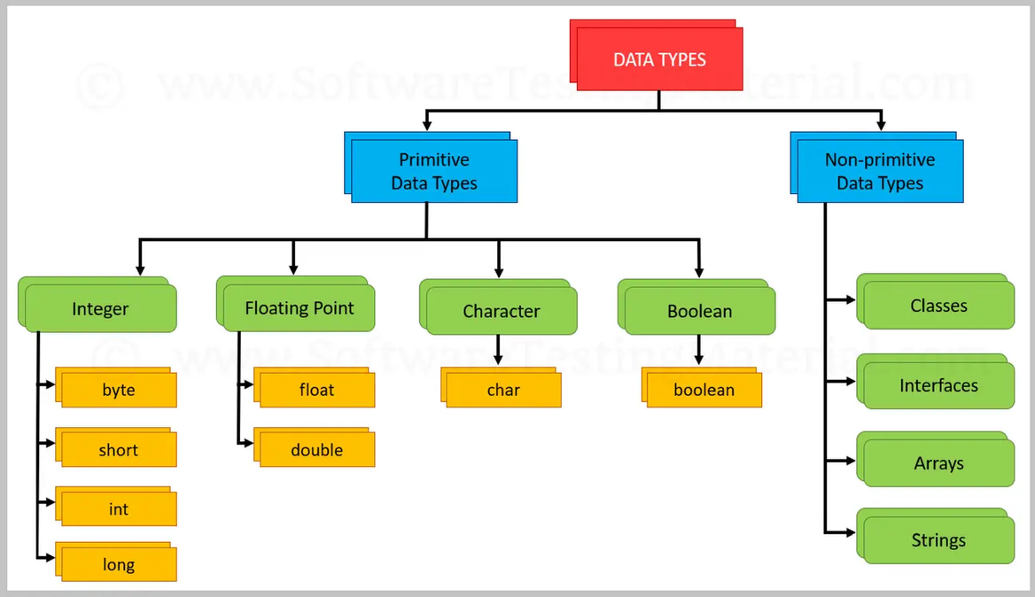
DATA TYPES
Data types in Java are of different sizes and values that can be stored in the variable that is made as per convenience and circumstances to cover up all test cases. Java has two categories in which data types are segregated
  Primitive Data Type: such as Boolean, char, int, short, byte, long, float, and double
  Non-Primitive Data Type or Object Data type: such as String, Array, etc.

Slide 7
Data Type | Default Value | Default size | Range
byte | 0 | 1 byte or 8 bits | -128 to 127
short | 0 | 2 bytes or 16 bits | -32,768 to 32,767
int | 0 | 4 bytes or 32 bits | 2,147,483,648 to 2,147,483,647
long | 0 | 8 bytes or 64 bits | 9,223,372,036,854,775,808 to 9,223,372,036,854,775,807
float | 0.0f | 4 bytes or 32 bits | 1.4e-045 to 3.4e+038
double | 0.0d | 8 bytes or 64 bits | 4.9e-324 to 1.8e+308
char | ‘\u0000’ | 2 bytes or 16 bits | 0 to 65536
boolean | FALSE | 1 byte or 2 bytes | 0 or 1

Slide 8
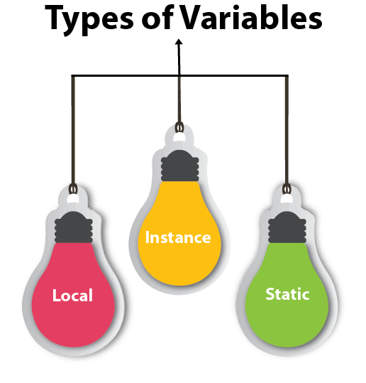
Java Variables
A variable is the name of a reserved area allocated in memory. In other words, it is a name of the memory location. It is a combination of "vary + able" which means its value can be changed.
Local Variable: A variable declared within a method, accessible only inside that method and not visible to others.
Instance Variable: A variable declared in a class but outside any method, specific to each object instance.
Static Variable: A variable declared as static, shared among all instances of a class, with memory allocated once during class loading.

Slide 9
Constants, Variables, and Formatting
Literal and Symbolic Constants
Java allows the use of both literal and symbolic constants, which are immutable values that cannot be changed during program execution.
Static Variables and Methods
Static members in Java are associated with the class itself, rather than individual objects, and can be accessed without creating an instance of the class.
Formatted Output with printf()
The printf() method in Java allows for the formatting of output, including the use of placeholders and conversion characters.

Slide 10
OPERATORS
Relational and Boolean Logical Operators
Relational operators, such as <, >, and ==, allow for the comparison of values, while Boolean logical operators, like &&, ||, and !, enable complex logical operations.
Arithmetic, Increment/Decrement, and Ternary Operators
Java supports a wide range of operators for performing mathematical operations, incrementing or decrementing values, and conditional expressions.
Operator Precedence and Associativity
Java follows a well-defined order of operations, or precedence, and associativity rules that determine the sequence in which operators are evaluated.

Slide 11
Bitwise AND (&)
The bitwise AND operator performs a bit-by-bit comparison, setting the resulting bit to 1 if both input bits are 1.
Bitwise OR (|)
The bitwise OR operator sets the resulting bit to 1 if either or both of the input bits are 1.
Bitwise XOR (^)
The bitwise XOR operator sets the resulting bit to 1 if either, but not both, of the input bits are 1.
Bitwise NOT (~)
The bitwise NOT operator flips the bits, changing 1 to 0 and 0 to 1.

Slide 12
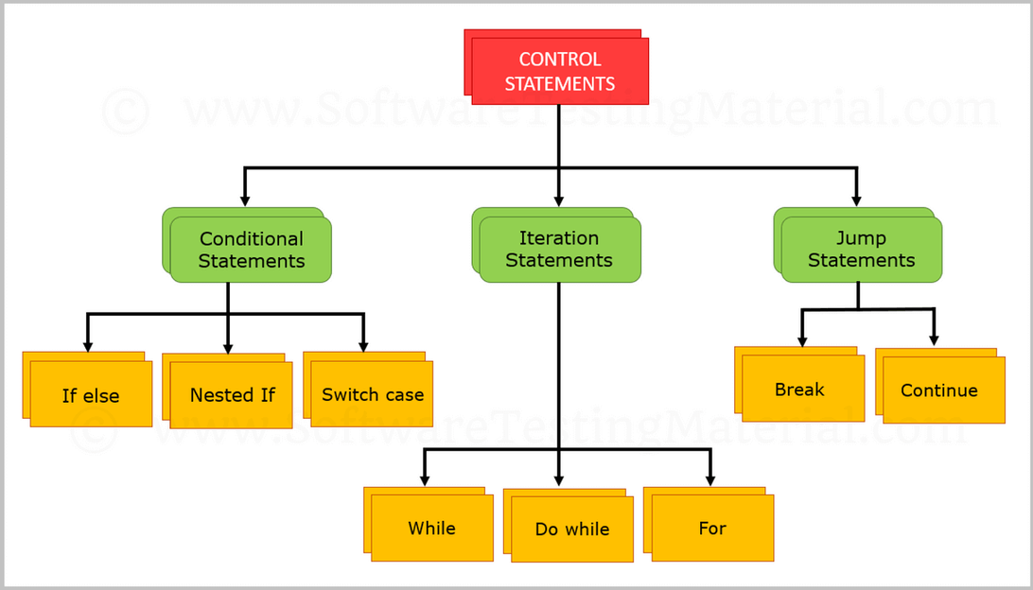
CONTROL STATEMENTS
  Conditional Statements
  Iterative Statements
  Jump statements

Slide 13
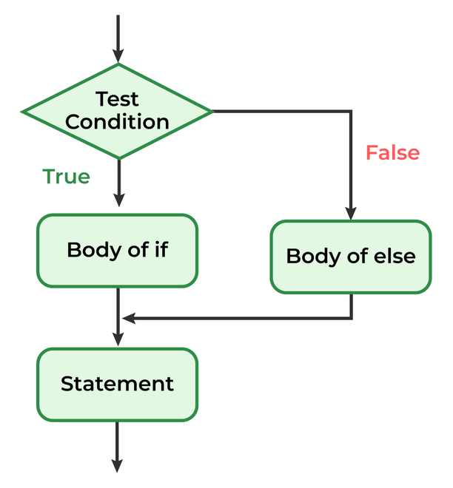
if-else statements
In Java, the if-else statement is used to execute code based on a condition. If the condition is true, the code within the if block runs; otherwise, the code in the else block executes. This allows for decision-making in your programs.
if (condition) {
// Code to execute if the condition is true
} else {
// Code to execute if the condition is false
}

Slide 14
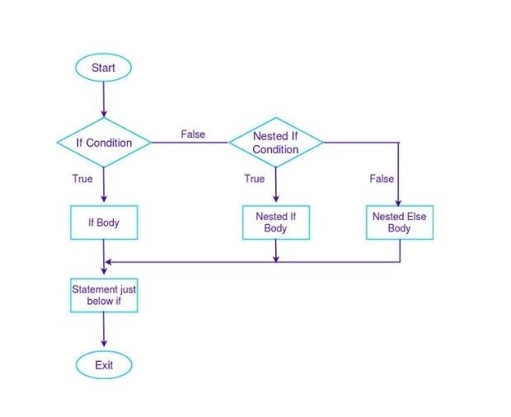
Nested if
A nested if in Java is an if statement placed inside another if or else block. This structure allows you to check multiple conditions in a hierarchical manner, where the inner if block is evaluated only if the outer if condition is true.
if (condition1) {
if (condition2) {
// Code to execute if both condition1 and condition2 are true
}
}

Slide 15
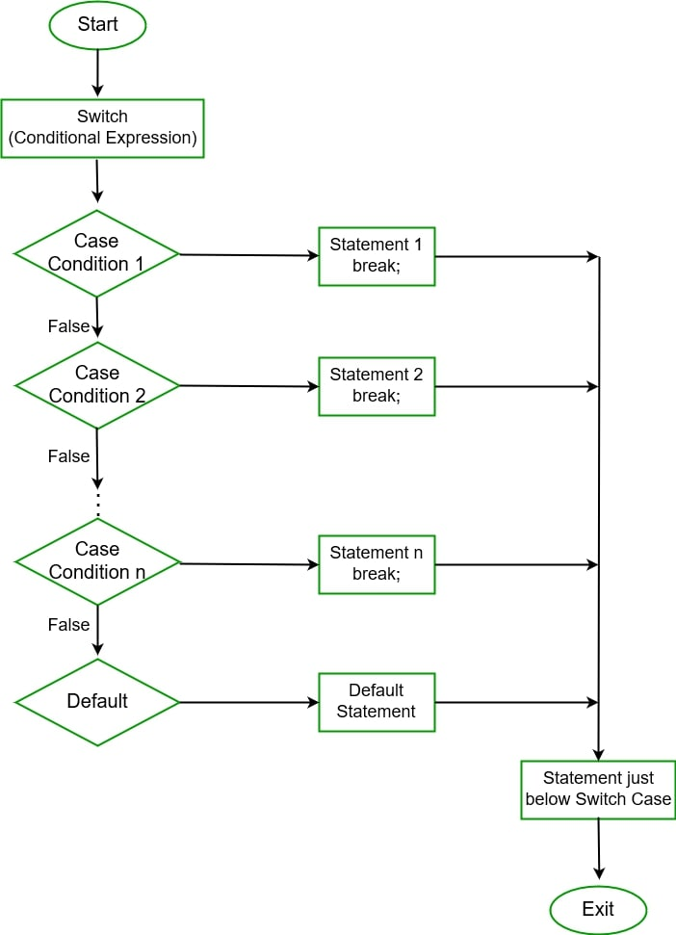
Switch Case
In Java, the switch statement is used to execute one of many possible blocks of code based on the value of an expression. It's an alternative to multiple if-else statements, making the code more readable when dealing with multiple conditions.
switch (expression) {
case value1:
// Code to execute if expression equals value1
break;
case value2:
// Code to execute if expression equals value2
break;
default:
// Code to execute if none of the cases match
}

Slide 16
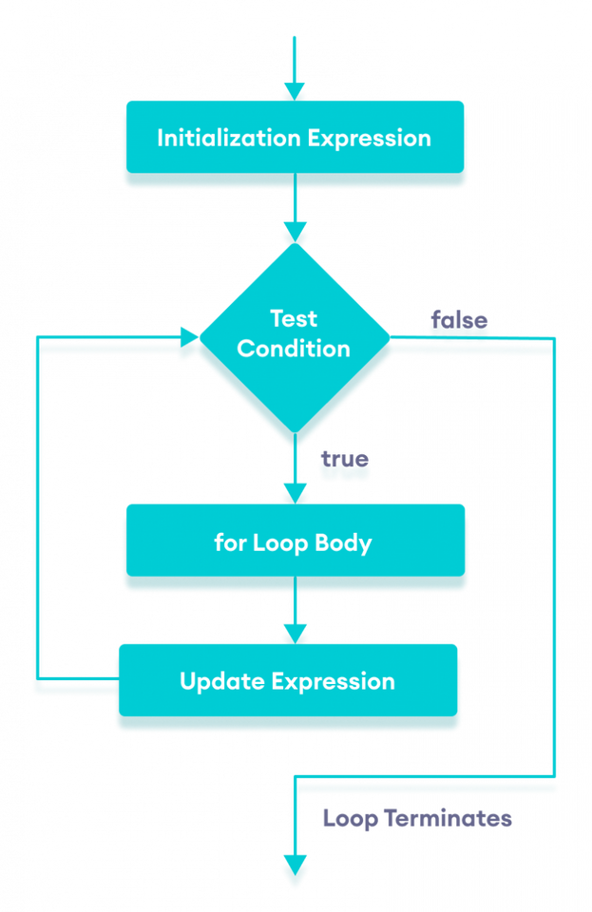
For Loop
A for loop in Java is used to repeat a block of code a specific number of times. It's ideal when the number of iterations is known beforehand.
for (int i = 1; i <= 5; i++) {
System.out.println(i);
}

Slide 17
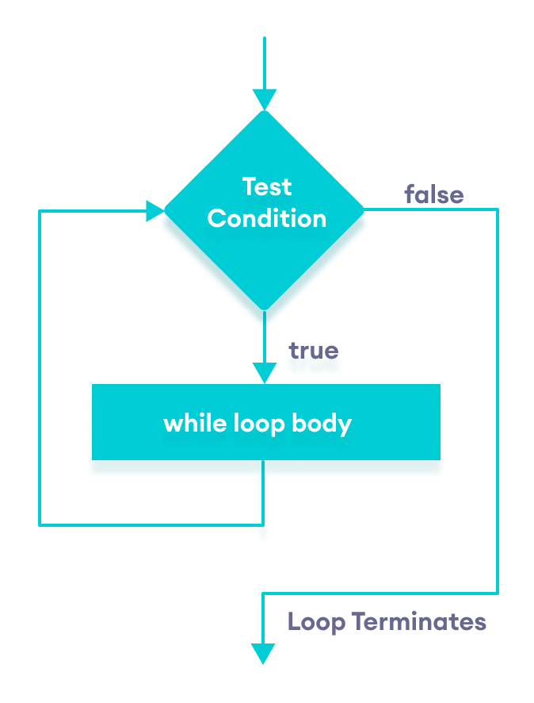
While Loop
A while loop repeats a block of code as long as a specified condition remains true. It is commonly used when the number of iterations isn't predetermined.
int i = 1;
while (i <= 5) {
System.out.println(i);
i++;
}

Slide 18
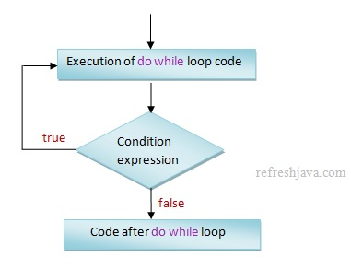
do while loop
The do-while loop is similar to the while loop, but it guarantees that the code block runs at least once, as the condition is checked after the loop body.
int i = 1;
do {
System.out.println(i);
i++;
} while (i <= 5);

Slide 19
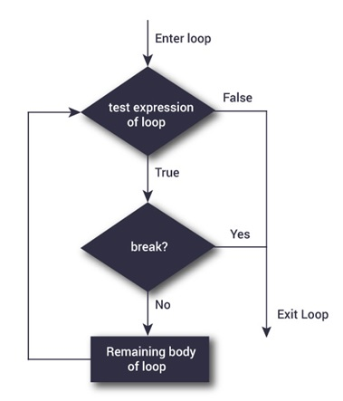
Break Statement
The break statement in Java is used to exit a loop or switch statement prematurely, immediately stopping the loop's execution and continuing with the code that follows.
for (int i = 1; i <= 5; i++) {
if (i == 3) {
break; // Exit loop when i equals 3
}
System.out.println(i);
}
// Output: 1, 2

Slide 20
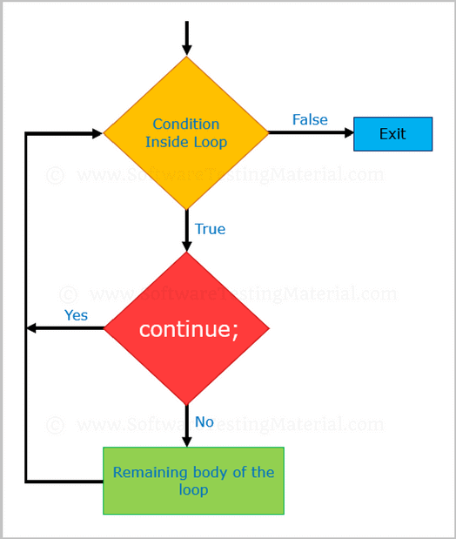
Continue Statement
The continue statement skips the current iteration of a loop and proceeds with the next iteration, allowing you to bypass specific conditions within the loop.
for (int i = 1; i <= 5; i++) {
if (i == 3) {
continue; // Skip the rest of the loop when i equals 3
}
System.out.println(i);
}
// Output: 1, 2, 4, 5

Slide 21
thank
you

